Slide 1
Kingsley Food Service
Stag Café News
KAS will be participating in the Michigan School Meals Program again this year. What does that mean? ALL students enrolled are eligible to one breakfast and lunch at school with NO charge.
If you have not completed your household Education Benefits Form please go to Kingsley.familyportal.cloud or pick up a paper form at any school office.
Food Allergies or
Special Dietary Needs?
If your child has a food disability allergy or dietary needs we must receive a
Special Dietary Statement, completed by a licensed medical professional (MD, DO, NP, PA) if they plan on eating a school meal. Our child nutrition team is not able to monitor or safe guard any food allergies in our cafes unless we receive a special dietary form on file for your student, per the Michigan Department of Education. After receiving, we can make a plan to safe guard for food allergies in our cafes, provide more information including ingredient labels, a specific dietary plan, and more.
Dietary Forms are available on Kingsley’s website
Food Service Director
Kristy Donner
kdonner@kingsleyschools.org
WHAT’S ON THE MENU?
Check it out at
https://kingsley.nutrislice.com/ or
download the Nutrislice App on your Smart phone
Things to Come
Elementary School:
Lucky tray day 2nd Tuesday of EVERY month
September 5th National Pizza day
September 18th National Cheeseburger Day
October 2nd Cookie Day
October 8th National Pierogi Day
October 17th National Pasta Day
Middle (4-8) / High School:
Wednesdays: International Travel
Fridays: BBQ picnic style lunch days
September: Breakfast prize month –get entered into a prize drawing every time you come and get school breakfast for the month!!
October 2nd: Sweet treat day
October 11th: Homecoming Fun

Slide 2
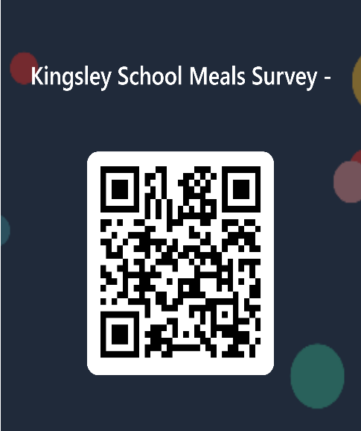
Did You Know??
What is included with a School Breakfast & Lunch?
Adding Funds to Students Breakfast & Lunch Accounts
All the items you could choose for a complete meal
Kingsley.familyportal.cloud
One breakfast and lunch are free for each student. Extra items maybe available for purchase
Accounts must have funds or cash in hand to purchase extra items.
Additionally, deposits can be made at your child’s school by sending cash or a check payable to Kingsley Schools for no fee.
A meal includes an entrée, fruit, veggies, and a low-fat milk. Our team will encourage students to take advantage of the fruit and vegetable bar! Therefore, if a team member sees your child with only an entrée we will encourage them to grab a fruit or veggie, however, it is always the students choice.
Students must take a fruit or vegetable with the entrée to qualify for a free breakfast or lunch.
As participants in the National School Breakfast and Lunch program, we are obligated to follow all regulations. These include serving sizes, calorie content, and nutritional guidelines pertaining to all food offered for sale during the school day.
Enjoy the Food Service Industry, but wish you had weekends and holidays off?
Enjoy working with kids and in a fun environment?
We are currently looking for Part Time and On call Workers.
Competitive hourly pay & benefits
Hours are Mon-Fri with major holidays off
Apply Online at: Compassgroupcareers.com or indeed.com
USDA Nondiscrimination Statement
In accordance with federal civil rights law and U.S. Department of Agriculture (USDA) civil rights regulations and policies, this institution is prohibited from discriminating on the basis of race, color, national origin, sex (including gender identity and sexual orientation), disability, age, or reprisal or retaliation for prior civil rights activity.

